Slide 1
Raspberry Pi
Stefan konzelmann
Mobile application development
Research assignment
25.10.2017
JAMK university of applied sciences

Slide 2
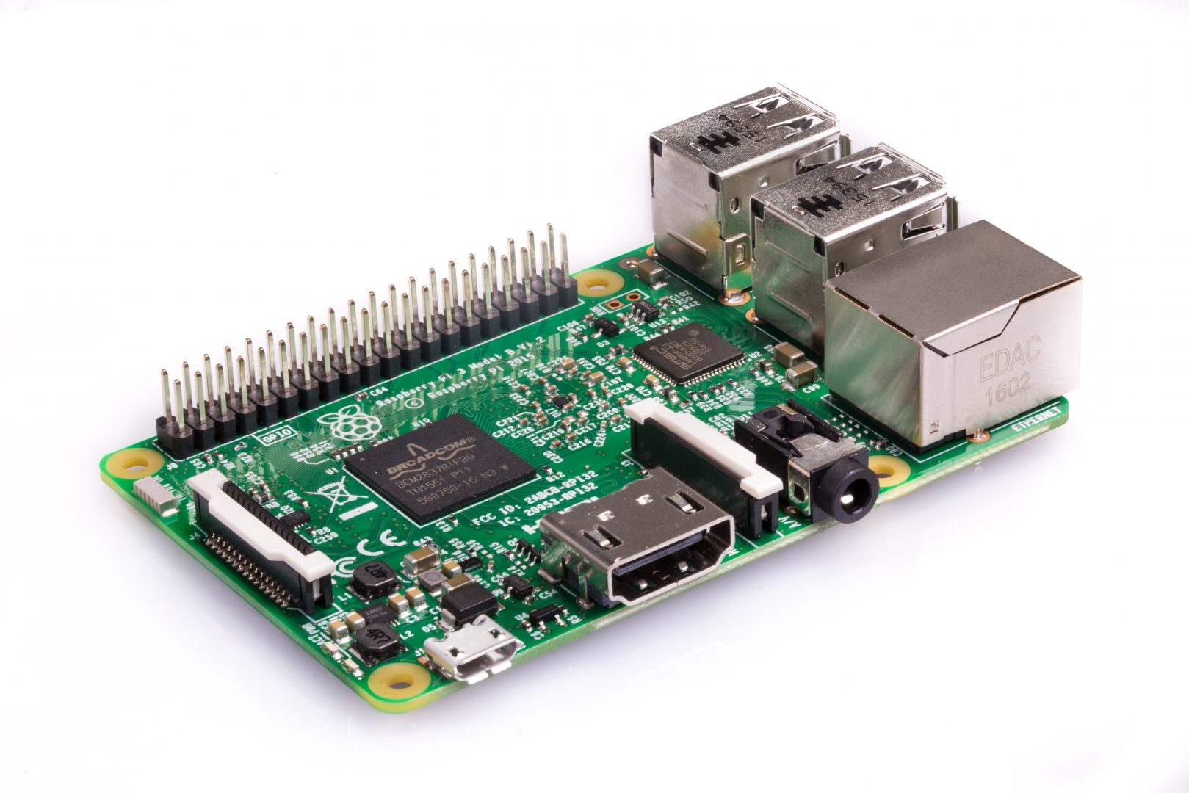
single-board computer (SBC)

Slide 3
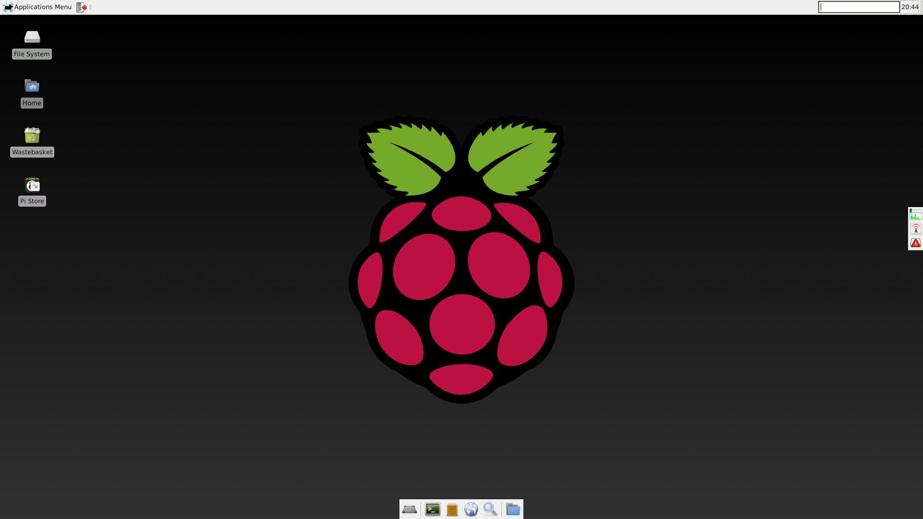
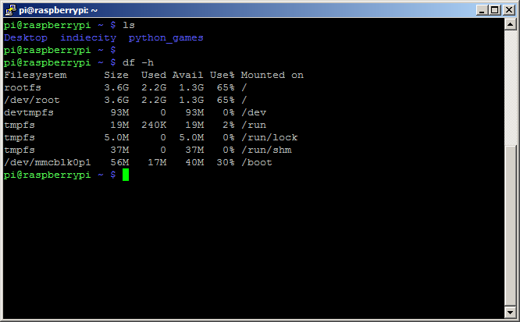
Input
Graphical user interface (GUI)
Command window

Slide 4
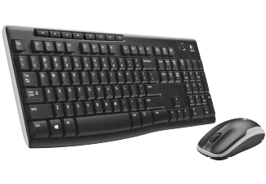
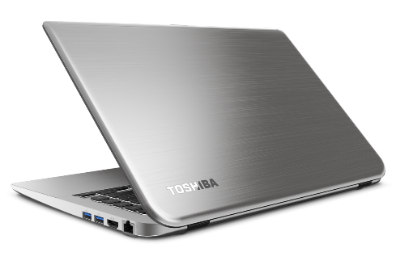
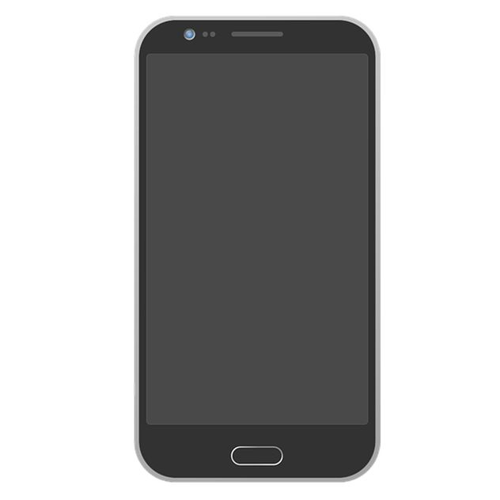
Command window
NOT REQUIERED
Command window

Slide 5
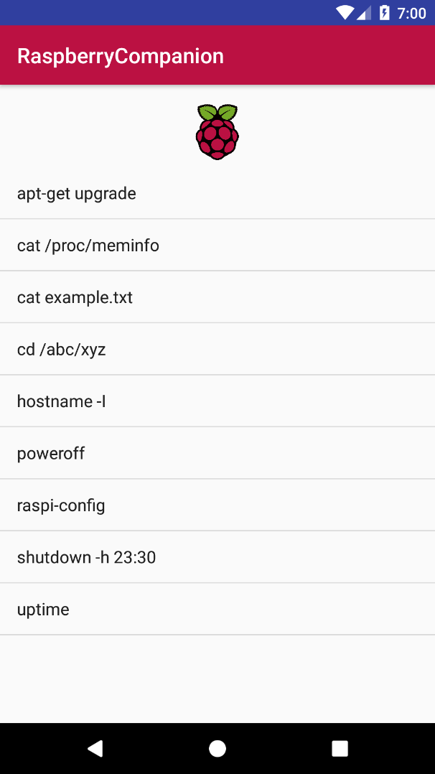
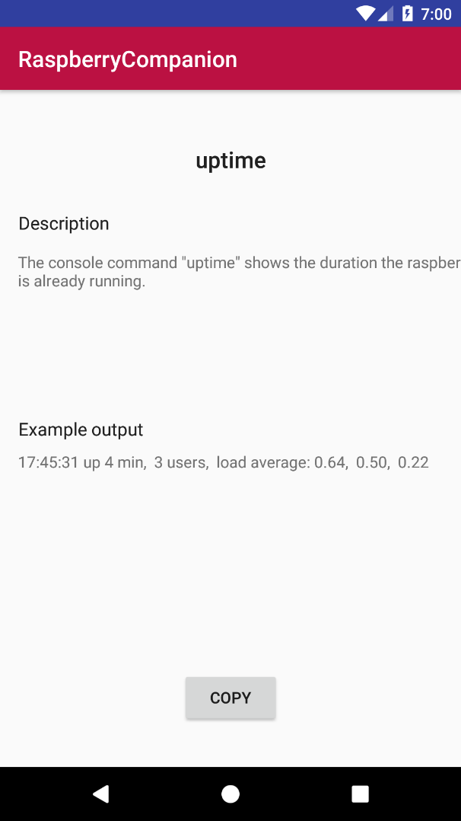
The App
Database
Information

Slide 6
Workflow I
1 create SSH connection
2 Select command

Slide 7
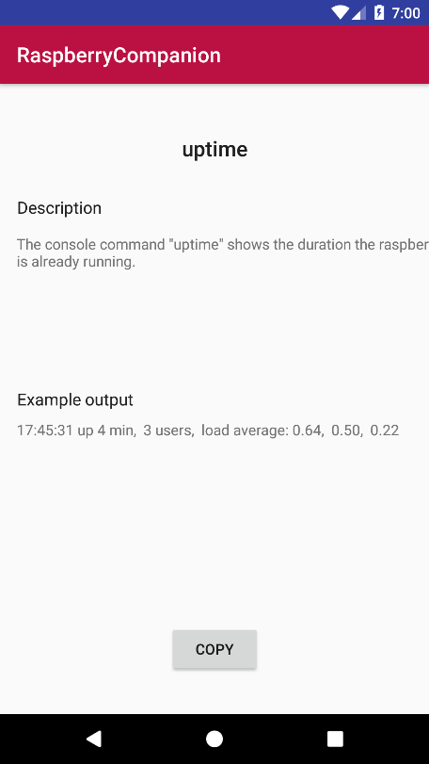
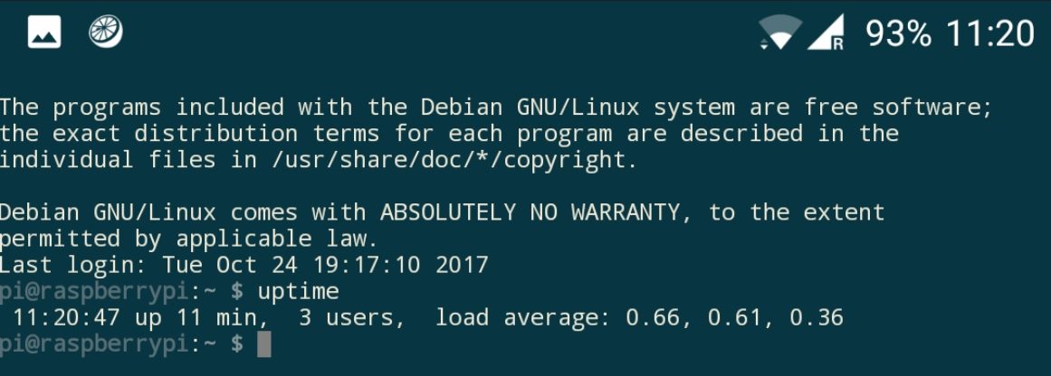
Workflow II
3 copy command
4 paste & execute command

Slide 8
What‘s next?
Editable database
Include SSH connection + console
Convenience features
Favourites
Recently used
Switching between apps not efficient
One app for everything
Adding own commands critical utility

Slide 9
Thank you for your Attention!

Slide 10
Overview
Raspberry Pi
Input methods
The App
Example Workflow
What‘s next?

